Slide 1

RNN on Time Series Data - More Efficient Implementation

Slide 2
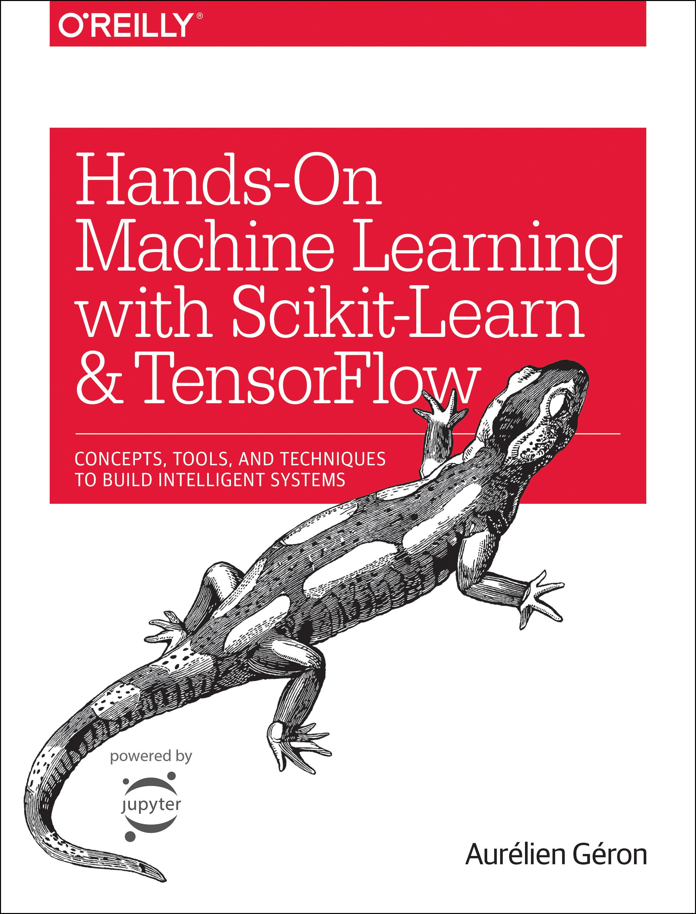
Reference
Chapter 14 (O'Reilly) of Hands-On ML
Youtube on Saving Figure
Youtube on Numpy Broadcasting
Youtube on RNN on Time Series Data
Youtube
Code

Slide 3
Data

Slide 4
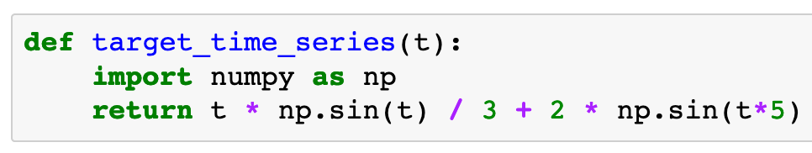

Slide 5
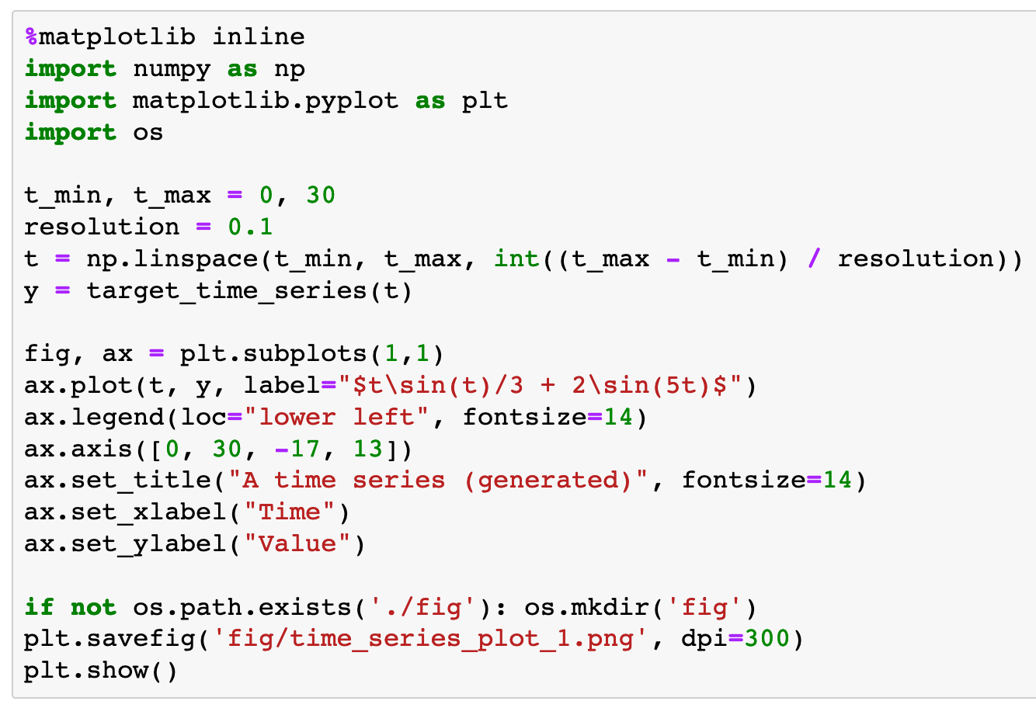

Slide 6
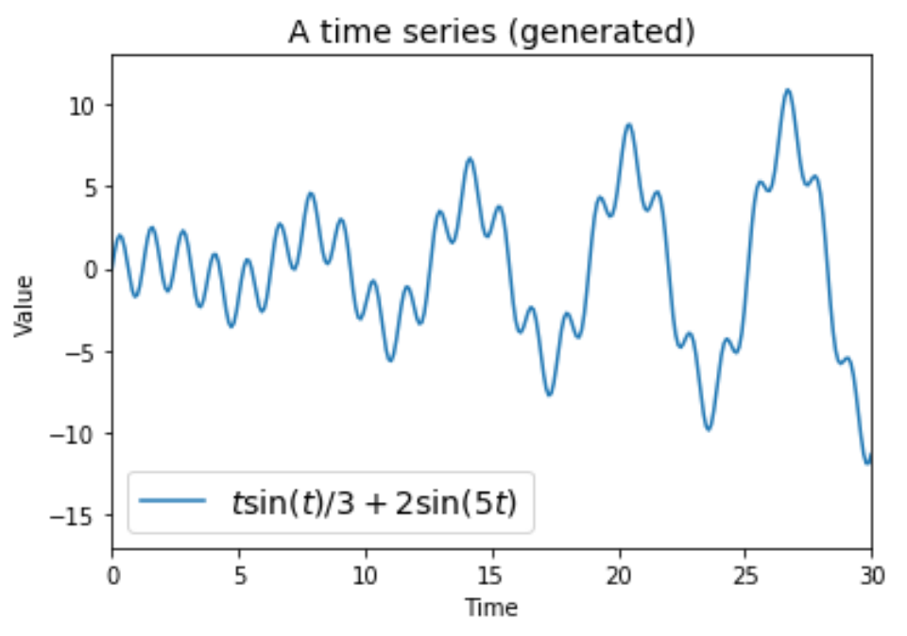

Slide 7
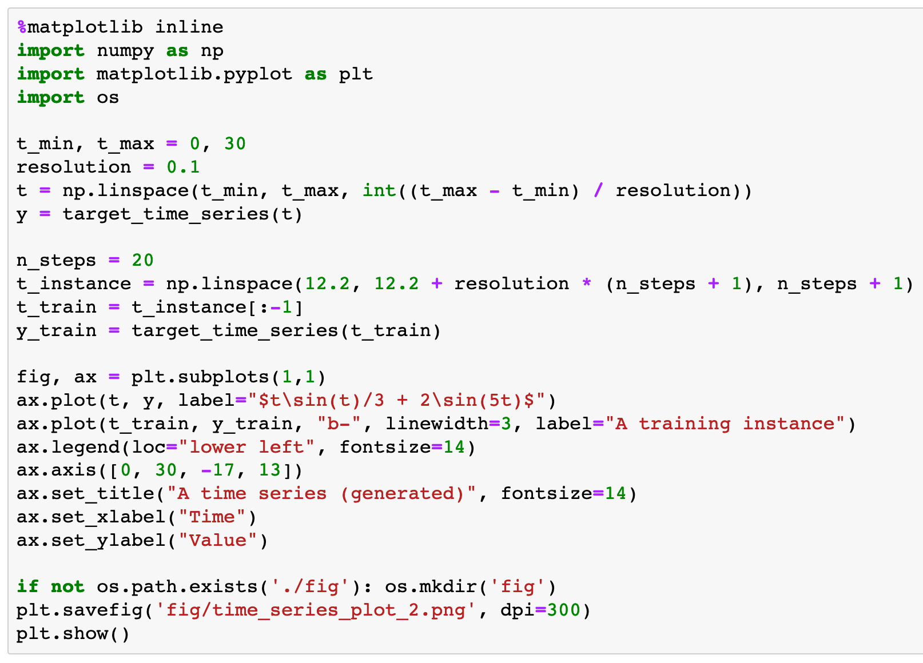

Slide 8
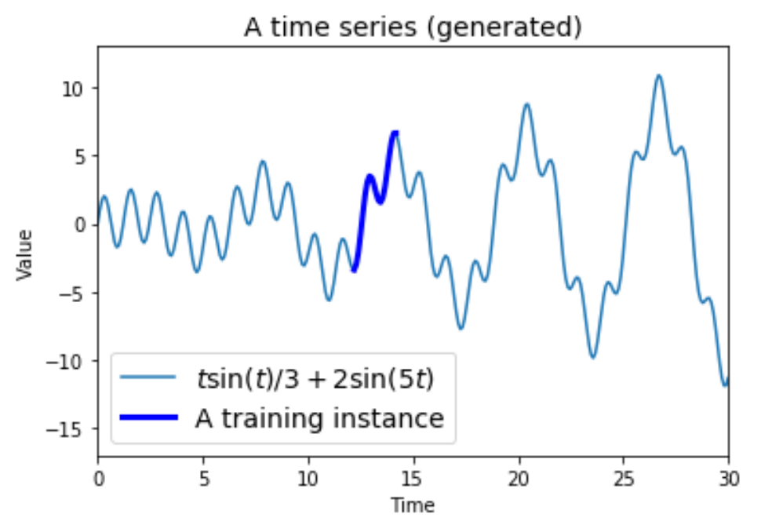

Slide 9
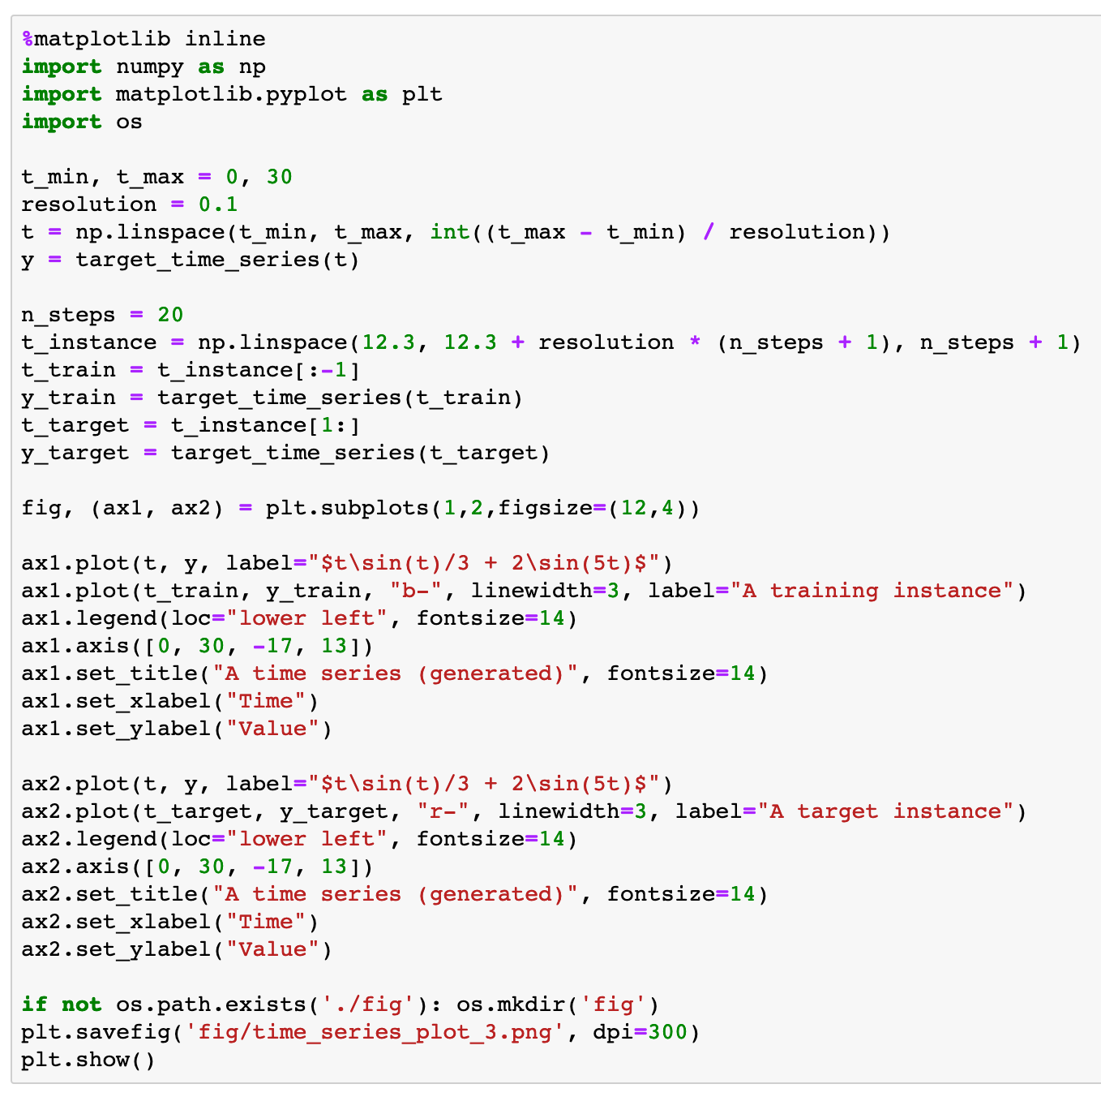

Slide 10
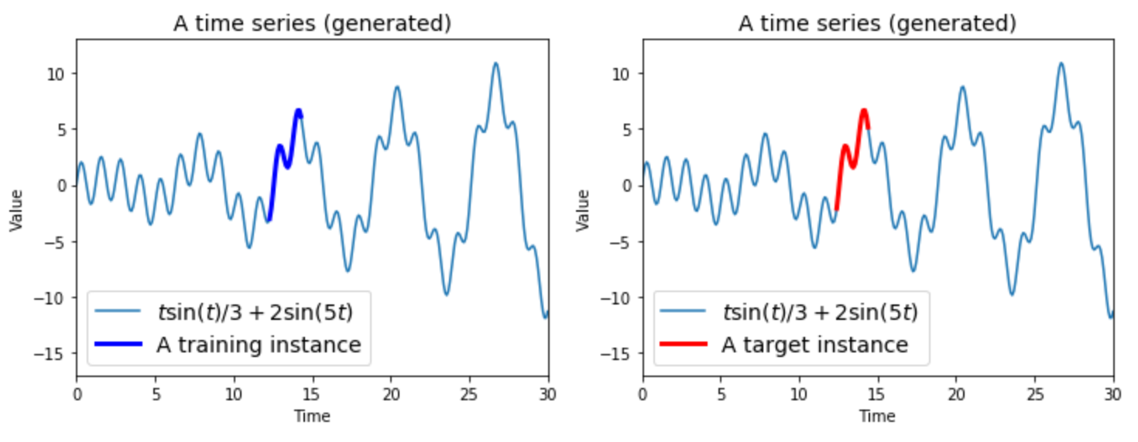

Slide 11
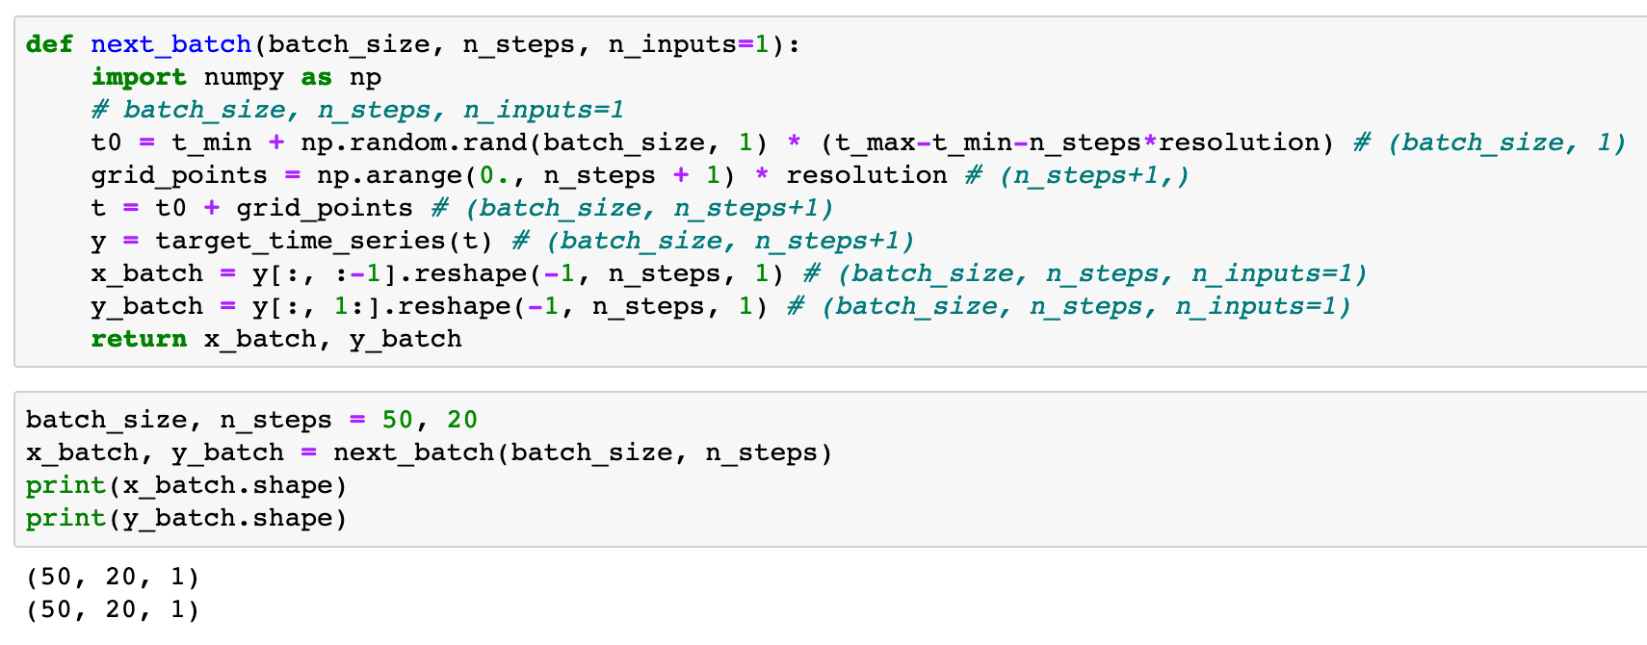


Slide 13
Warm Up

Slide 14
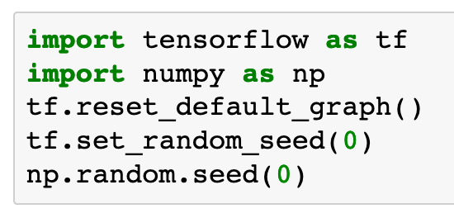

Slide 15
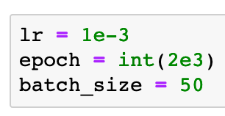

Slide 16
Graph

Slide 17
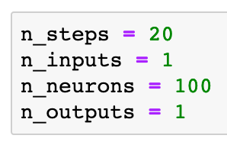

Slide 18
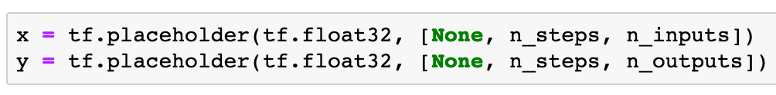

Slide 19
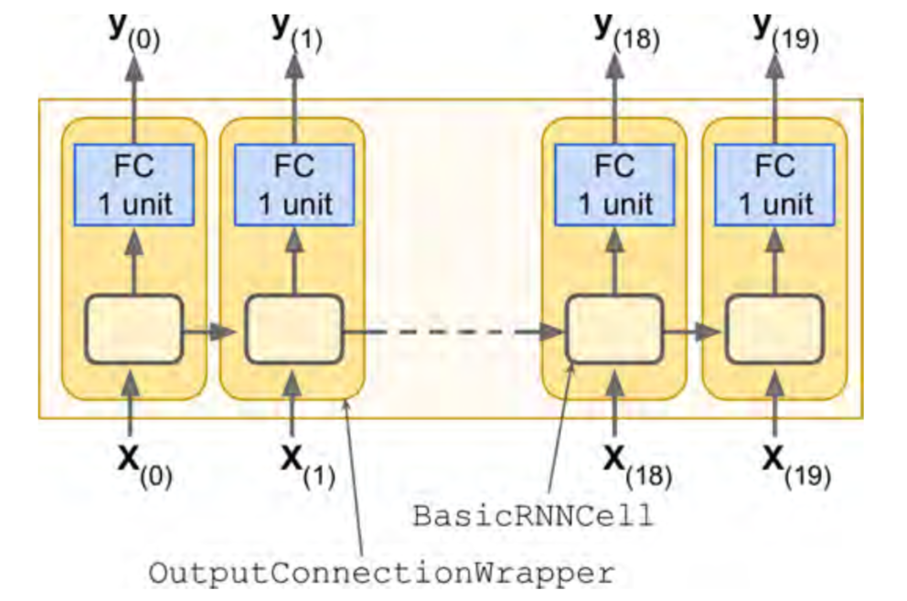
Previously
Chapter 14 (O'Reilly) of Hands-On ML

Slide 20
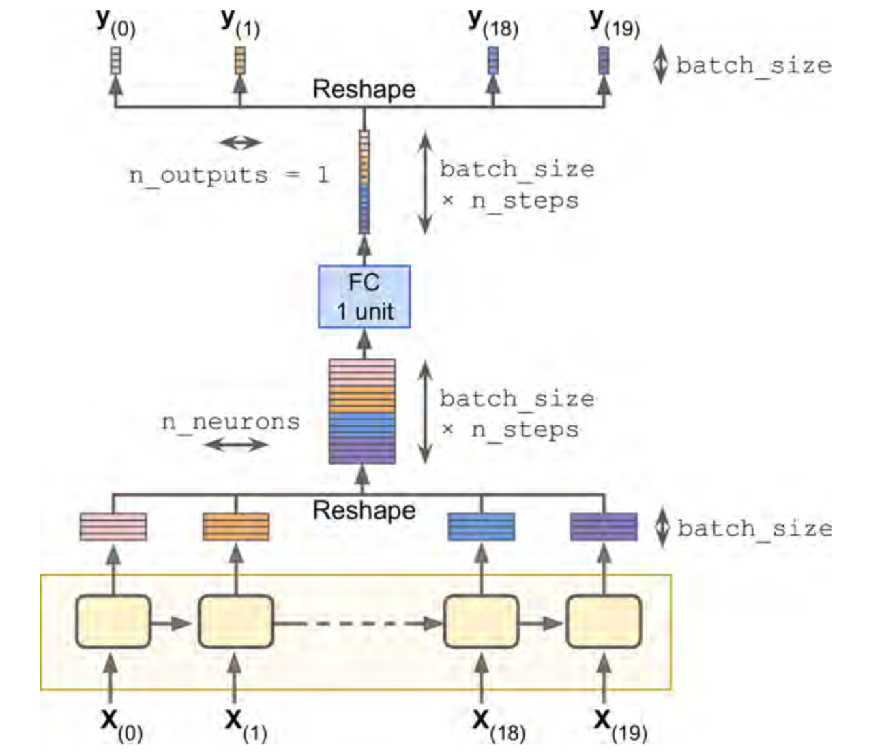
Now
Chapter 14 (O'Reilly) of Hands-On ML

Slide 21
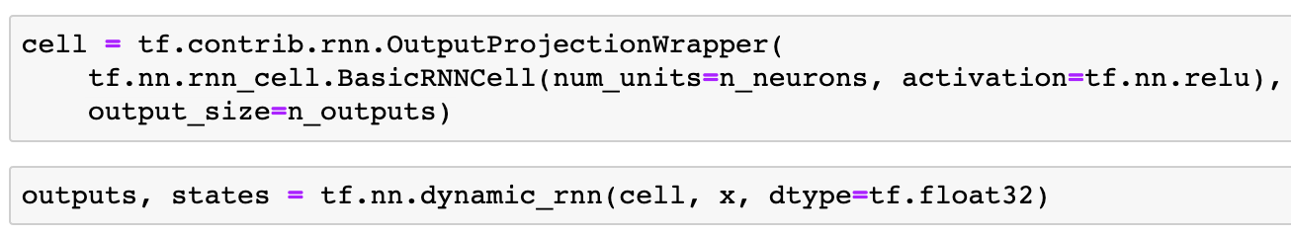
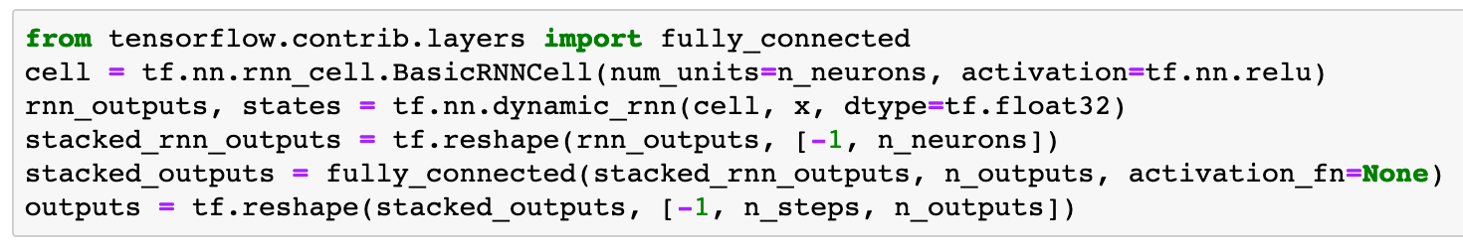
Previously
Now

Slide 22
Previously
Now

Slide 23
Chapter 14 (O'Reilly) of Hands-On ML

Slide 24
Chapter 14 (O'Reilly) of Hands-On ML
x

Slide 25
Chapter 14 (O'Reilly) of Hands-On ML
x
(batch_size, n_steps, n_inputs)

Slide 26
rnn_outputs
Chapter 14 (O'Reilly) of Hands-On ML
x
(batch_size, n_steps, n_inputs)

Slide 27
rnn_outputs
(batch_size, n_steps, n_neorons)
Chapter 14 (O'Reilly) of Hands-On ML
x
(batch_size, n_steps, n_inputs)

Slide 28
stacked_rnn_outputs
rnn_outputs
(batch_size, n_steps, n_neorons)
Chapter 14 (O'Reilly) of Hands-On ML
x
(batch_size, n_steps, n_inputs)

Slide 29
stacked_rnn_outputs = tf.reshape(rnn_outputs, [-1, n_neurons])
stacked_rnn_outputs
rnn_outputs
(batch_size, n_steps, n_neorons)
Chapter 14 (O'Reilly) of Hands-On ML
x
(batch_size, n_steps, n_inputs)

Slide 30
stacked_rnn_outputs = tf.reshape(rnn_outputs, [-1, n_neurons])
stacked_rnn_outputs
(batch_size*n_steps, n_neorons)
rnn_outputs
(batch_size, n_steps, n_neorons)
Chapter 14 (O'Reilly) of Hands-On ML
x
(batch_size, n_steps, n_inputs)

Slide 31
stacked_outputs
stacked_rnn_outputs = tf.reshape(rnn_outputs, [-1, n_neurons])
stacked_rnn_outputs
(batch_size*n_steps, n_neorons)
rnn_outputs
(batch_size, n_steps, n_neorons)
Chapter 14 (O'Reilly) of Hands-On ML
x
(batch_size, n_steps, n_inputs)

Slide 32
stacked_outputs = fully_connected(stacked_rnn_outputs, n_outputs, activation_fn=None)
stacked_outputs
stacked_rnn_outputs = tf.reshape(rnn_outputs, [-1, n_neurons])
stacked_rnn_outputs
(batch_size*n_steps, n_neorons)
rnn_outputs
(batch_size, n_steps, n_neorons)
Chapter 14 (O'Reilly) of Hands-On ML
x
(batch_size, n_steps, n_inputs)

Slide 33
stacked_outputs = fully_connected(stacked_rnn_outputs, n_outputs, activation_fn=None)
stacked_outputs
(batch_size*n_steps, 1)
stacked_rnn_outputs = tf.reshape(rnn_outputs, [-1, n_neurons])
stacked_rnn_outputs
(batch_size*n_steps, n_neorons)
rnn_outputs
(batch_size, n_steps, n_neorons)
Chapter 14 (O'Reilly) of Hands-On ML
x
(batch_size, n_steps, n_inputs)

Slide 34
outputs
stacked_outputs = fully_connected(stacked_rnn_outputs, n_outputs, activation_fn=None)
stacked_outputs
(batch_size*n_steps, 1)
stacked_rnn_outputs = tf.reshape(rnn_outputs, [-1, n_neurons])
stacked_rnn_outputs
(batch_size*n_steps, n_neorons)
rnn_outputs
(batch_size, n_steps, n_neorons)
Chapter 14 (O'Reilly) of Hands-On ML
x
(batch_size, n_steps, n_inputs)

Slide 35
outputs = tf.reshape(stacked_outputs, [-1, n_steps, n_outputs])
outputs
stacked_outputs = fully_connected(stacked_rnn_outputs, n_outputs, activation_fn=None)
stacked_outputs
(batch_size*n_steps, 1)
stacked_rnn_outputs = tf.reshape(rnn_outputs, [-1, n_neurons])
stacked_rnn_outputs
(batch_size*n_steps, n_neorons)
rnn_outputs
(batch_size, n_steps, n_neorons)
Chapter 14 (O'Reilly) of Hands-On ML
x
(batch_size, n_steps, n_inputs)

Slide 36
outputs = tf.reshape(stacked_outputs, [-1, n_steps, n_outputs])
outputs
(batch_size, n_steps, 1)
stacked_outputs = fully_connected(stacked_rnn_outputs, n_outputs, activation_fn=None)
stacked_outputs
(batch_size*n_steps, 1)
stacked_rnn_outputs = tf.reshape(rnn_outputs, [-1, n_neurons])
stacked_rnn_outputs
(batch_size*n_steps, n_neorons)
rnn_outputs
(batch_size, n_steps, n_neorons)
Chapter 14 (O'Reilly) of Hands-On ML
x
(batch_size, n_steps, n_inputs)

Slide 37
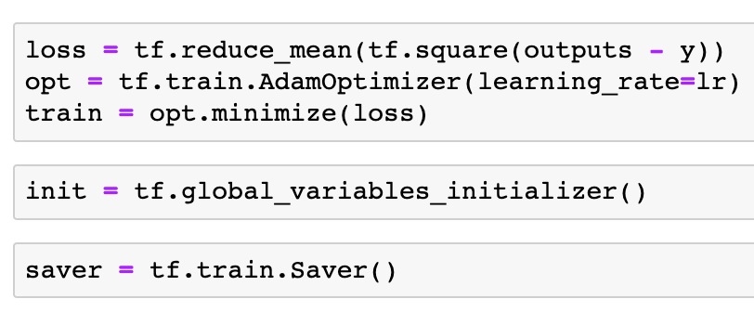

Slide 40
Session

Slide 41
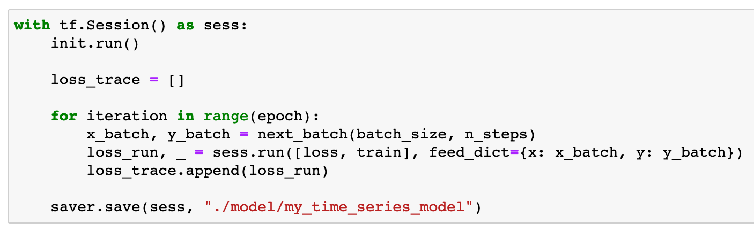

Slide 42
Report Result

Slide 43
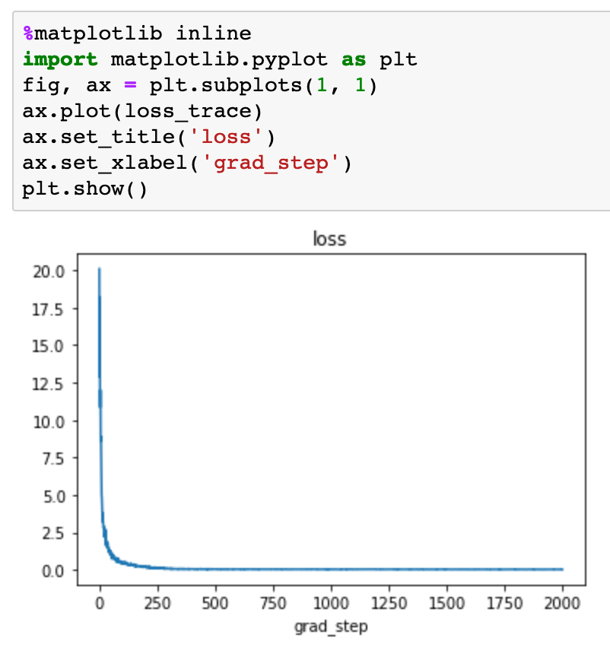

Slide 44
Restore and Predict

Slide 45
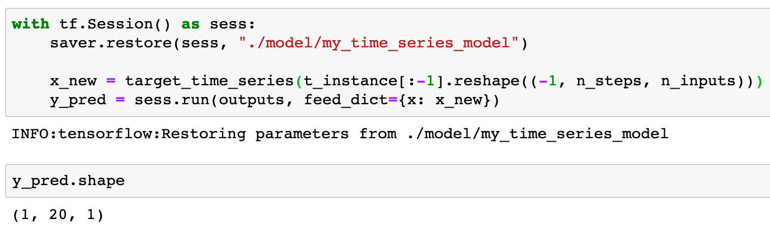

Slide 47
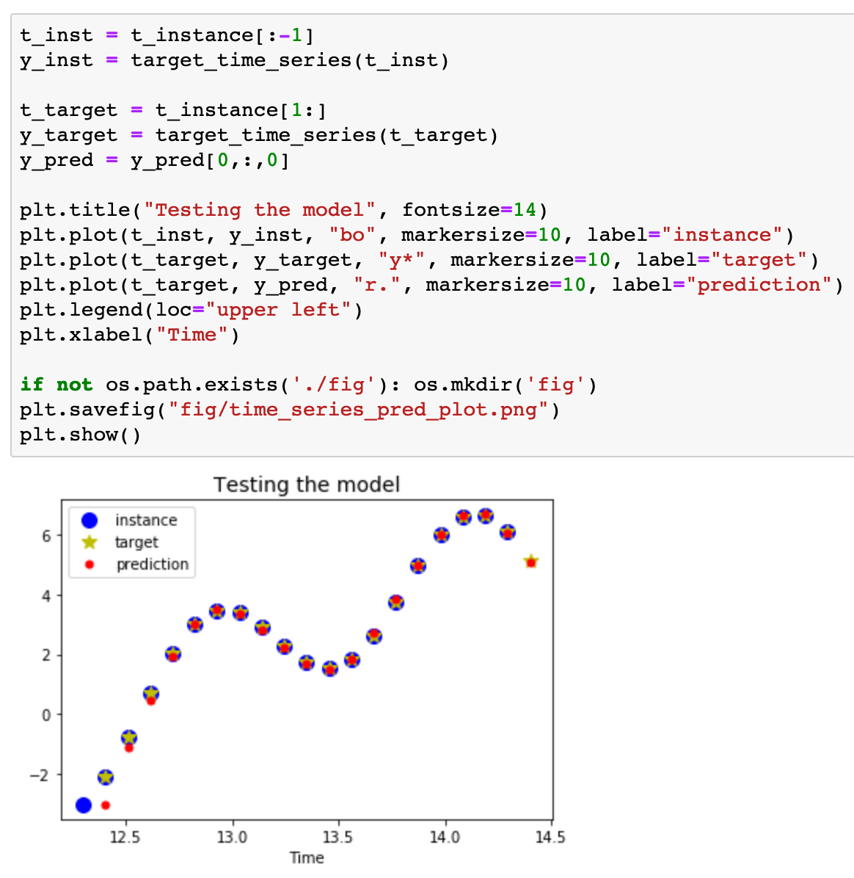

Slide 48
Now
Let’s Play with Code

